Slide 1


DIABETES PREDITION WITH MACHINE LEARNING
Y VEDAGNA AKHIL

Slide 2
ABSTRACT
Diabetes is a disease that occurs when your blood glucose, also called blood sugar, is too high.
Blood glucose is your main source of energy and comes from the food you eat. Insulin, a hormone made by the pancreas, helps glucose from food get into your cells to be used for energy.
Diabetes is a type of chronic disease which is more common among the people of all age groups.

Slide 3
OBJECTIVE
Predicting this disease at an early stage.
Help a person to take the necessary precautions.
And change their lifestyle accordingly to either prevent the occurrence of this disease.
Control the disease , for people who already have the disease.

Slide 4
TABLE CONTENTS
Gender
Alopecia
Itching
delayed healing
Obesity
Age
Genital thrush
muscle stiffness
weakness
visual blurring
Irritability
Polyphagia
partial paresis
sudden weight loss
Polydipsia
Polyuria

Slide 5
EXISTING SYSTEMS
Existing many research handled for diabetes detection. Data mining approach like clustering, classification were studied in existing system.
Diabetes prediction using algorithms such k-means, branch and bound algorithm was proposed. A basic diabetic dataset is chosen for carrying out the comparative analysis.
The importance of feature analysis for predicting diabetes by employing machine learning technique is discussed.

Slide 6
PROPOSED METHOD
The proposed system study is classification of Sylhet Diabetes Hospital dataset for diabetes as binary classification problem.
This is proposed to achieve through machine learning classification algorithms.
For machine learning, KNN , Logistic Regression, Random Forest are proposed.
The proposed system improves accuracy of prediction through proposed techniques.

Slide 7
METHODOLOGY
DATA COLLECTION
DATA VISUALIZATION
ENCODING THE DATA
SPLITING AND TRAINNIG THE DATA
EVALUATE RESULTS

Slide 8
CONCLUSION
FACTORS CAUSING DIABETES
PRECAUTIONS TO BE TAKEN

Slide 9
FACTORS CAUSING DIABETES

Slide 10
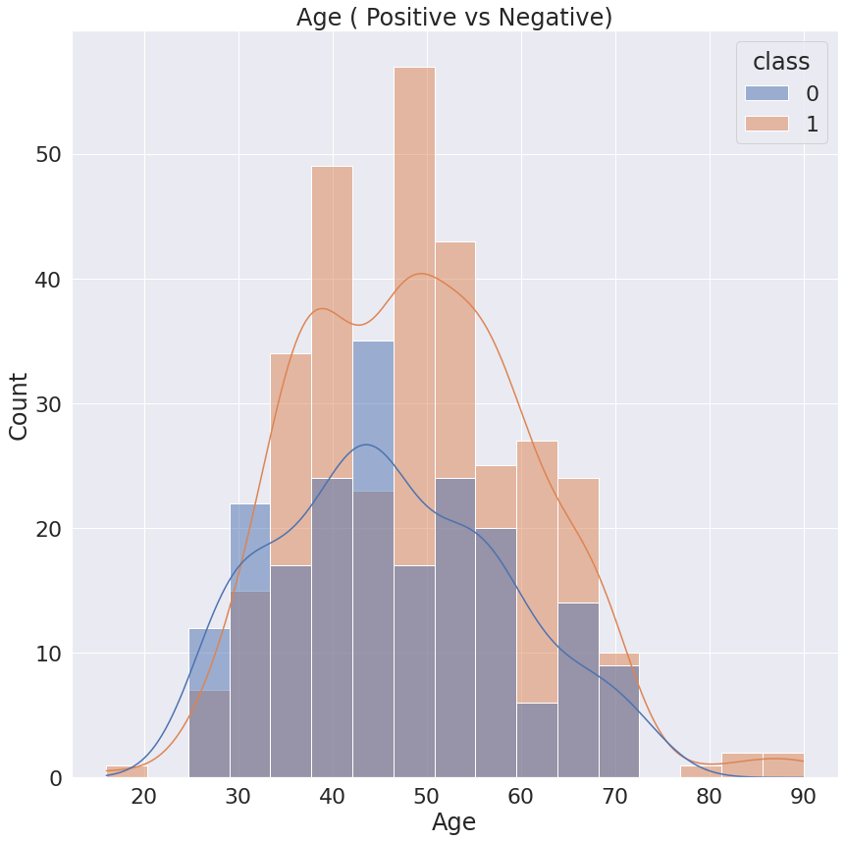
AGE
We can observe that the age group of 40 to 60 has the maximum no of positive cases of diabetes .
The risk for diabetes increases with age, making diabetes common in older adults.
People must be cautious over 40 to prevent diabetes .

Slide 11
GENDER
Most diabetic symptoms are the same in men and women.
But from the analysis females are more likely to be a diabetic positive than the males.
Females often have more serious complications and a greater risk of death.

Slide 12
MAJOR SYMPTOMS
POLYURIA , POLYDIPSIA
Polydipsia is the term given to excessive thirst and is one of the initial symptoms of diabetes.
Polyuria is a condition where the body urinates more than usual and passes excessive or abnormally large amounts of urine each time you urinate.
Your kidneys are forced to work overtime to filter and absorb the excess glucose. When your kidneys can't keep up, the excess glucose is excreted into your urine (POLYURIA), dragging along fluids from your tissues, which makes you dehydrated. This will usually leave you feeling thirsty (POLYDIPSIA).

Slide 13
CONTD..
SUDDEN WEIGHT LOSS
PARTIAL PARESIS
Following polyuria and polydipsia sudden weight loss and partial paresis are the major symptoms for diabetes.
In people with diabetes, insufficient insulin prevents the body from getting glucose from the blood into the body's cells to use as energy.
When this occurs, the body starts burning fat and muscle for energy, causing a reduction in overall body weight.
Paresis involves the weakening of a muscle or group of muscles.
It may also be referred to as partial or mild paralysis.
Unlike paralysis, people with paresis can still move their muscles.
These movements are just weaker than normal.

Slide 14
PRECAUTIONS TO BE TAKEN
Lose extra weight
Be more physically active
Eat healthy plant foods
Eat healthy fats
Skip fad diets and make healthier choices

Slide 15
VERSIONS OF PYTHON USED
PANDAS 1.1.5
SEABORN 0.11.2
NUMPY 1.19.5
SCIKIT- LEARN 1.0.1

Slide 16
THANK YOU

